Slide 1
Targeting Billion-Scale Compound Libraries with Deep Learning
A SARS-Cov-2 Example
A SARS-Cov-2 Example
Thomas Brettin
Strategic Program Manager
Argonne National Laboratory
July 7, 2021
PASC Mini

Slide 2
Introduction
CANDLE is developing a suite of software to support scalable deep learning on DOE supercomputing resources. In response to the unforeseen COVID-19 pandemic, we used the capabilities both in software and in personnel to quickly respond in pursuit of potential treatments options. With CANDLE in place, our response was instantaneous with the call from the Secretary of Energy, and support from the Office of Science and ECP , to bring our resources to bear on the problem.

Slide 3
Overview of the work
Identify protein targets and binding receptors
Perform initial docking
Train surrogate models to predict binding
Predict and the prioritize drug leads
Prioritize drug leads using molecular simulations
Perform live whole cell assays

Slide 4
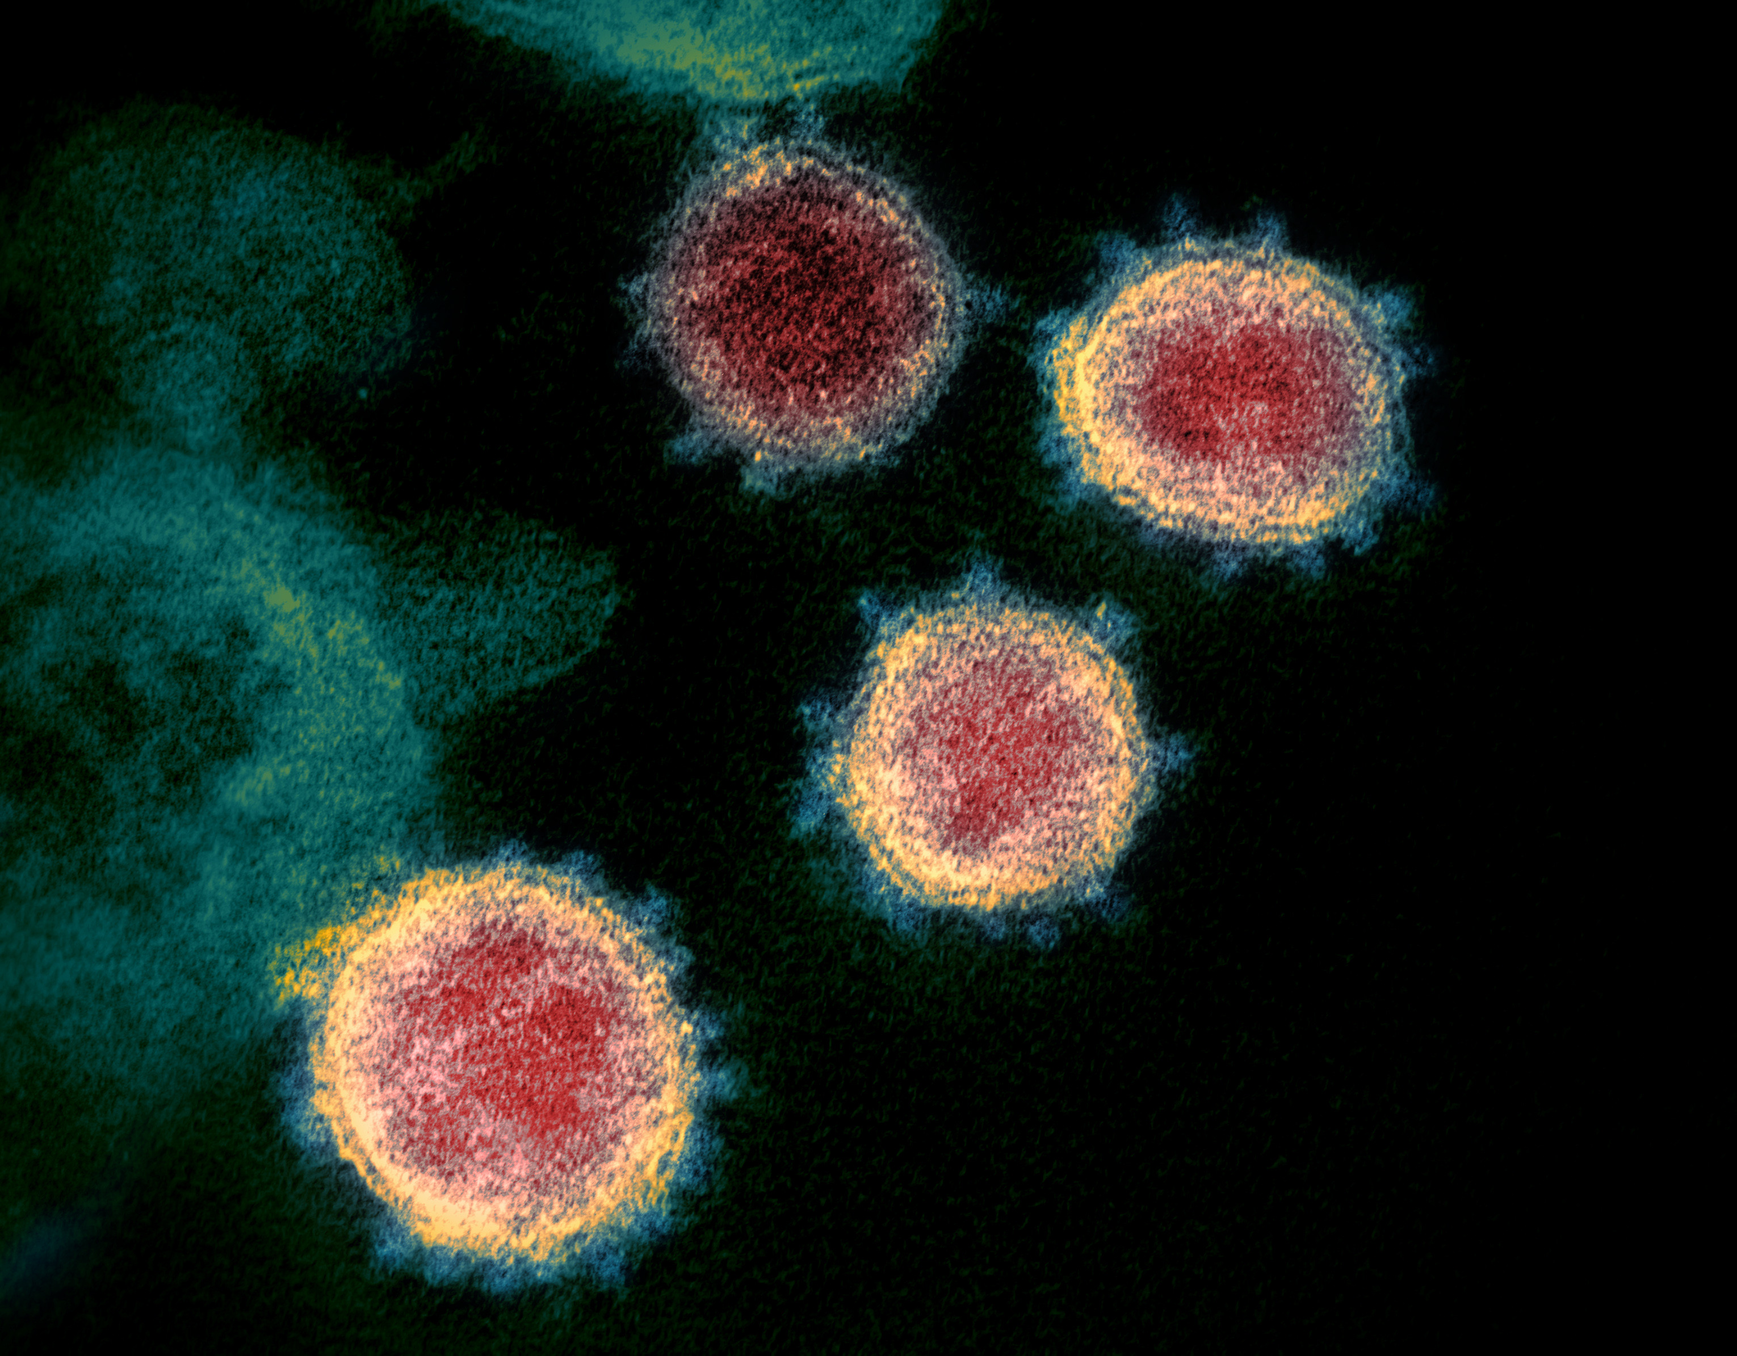
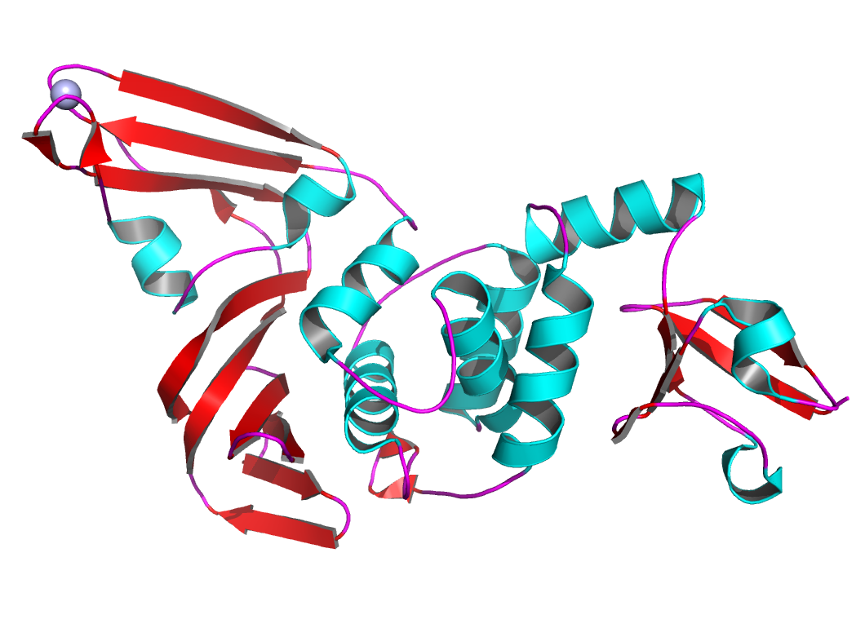
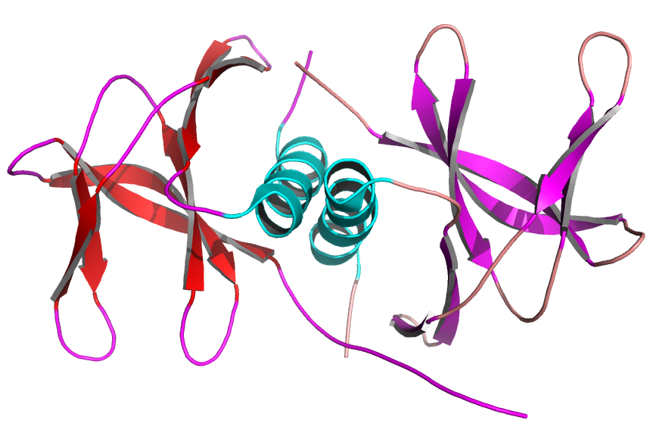
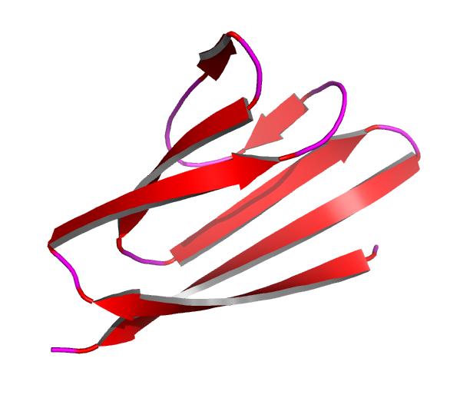
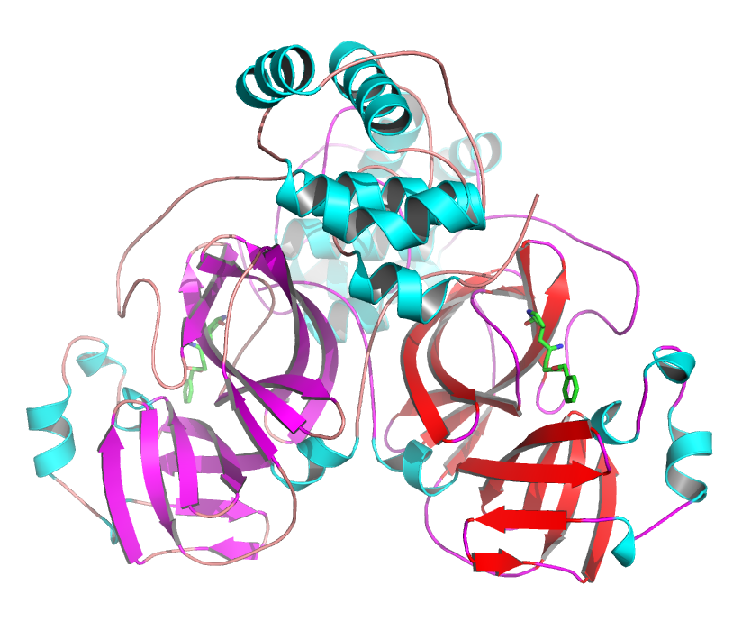
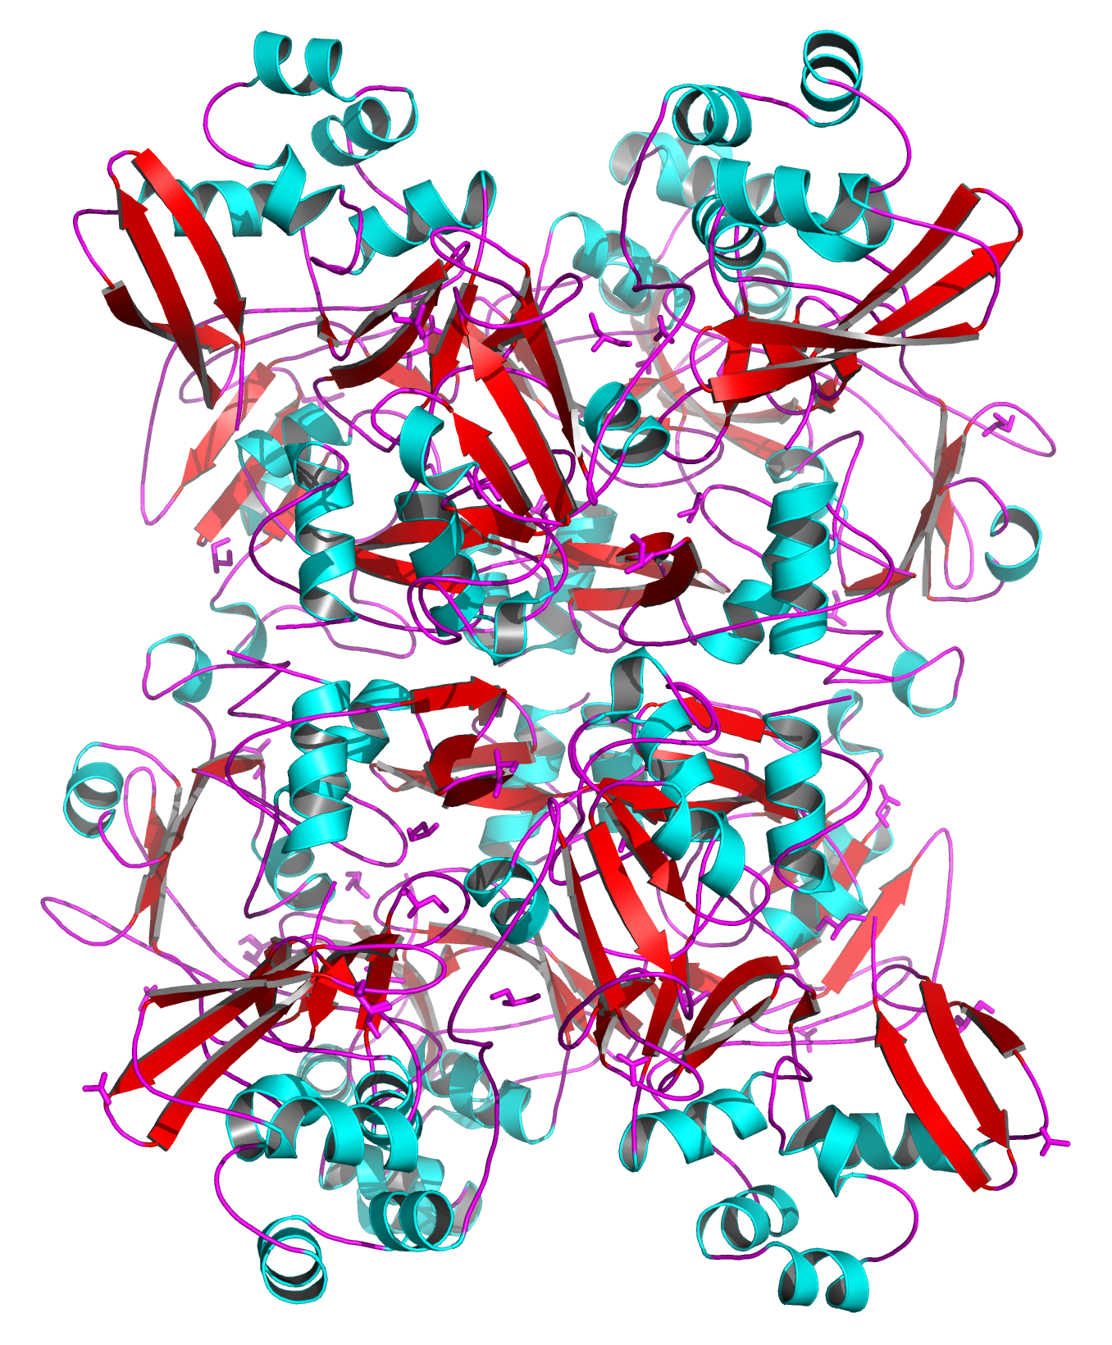
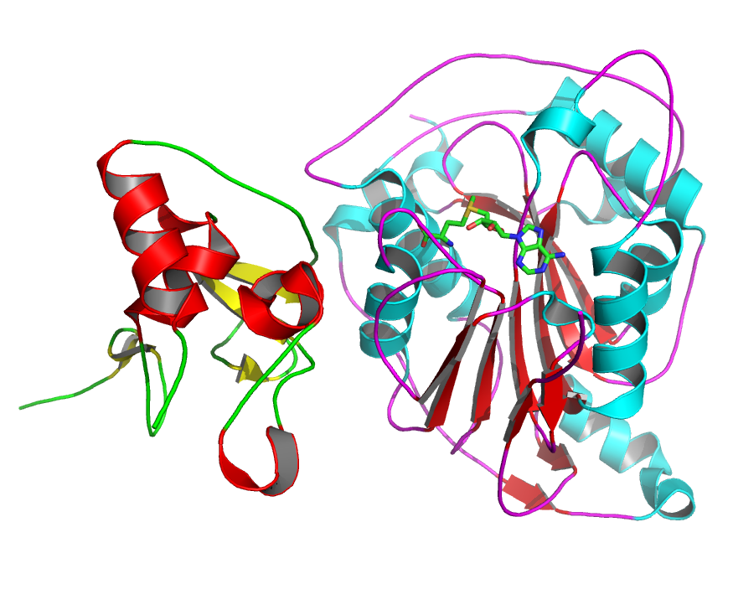
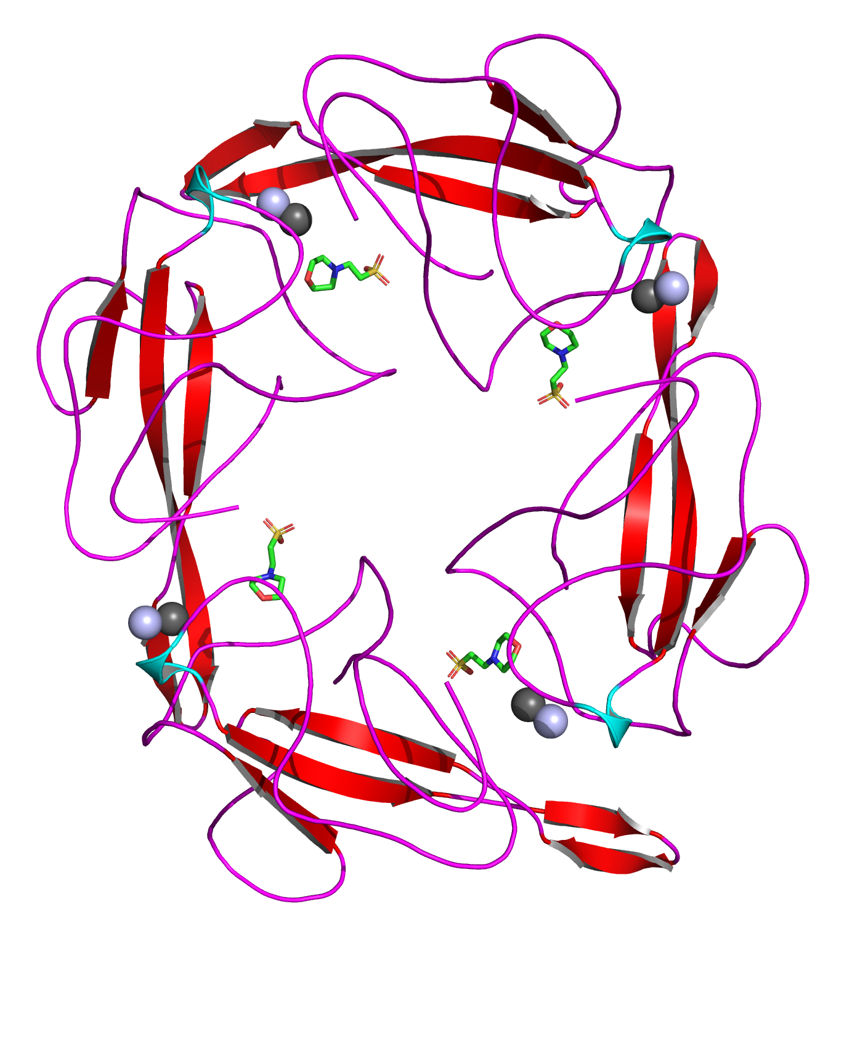
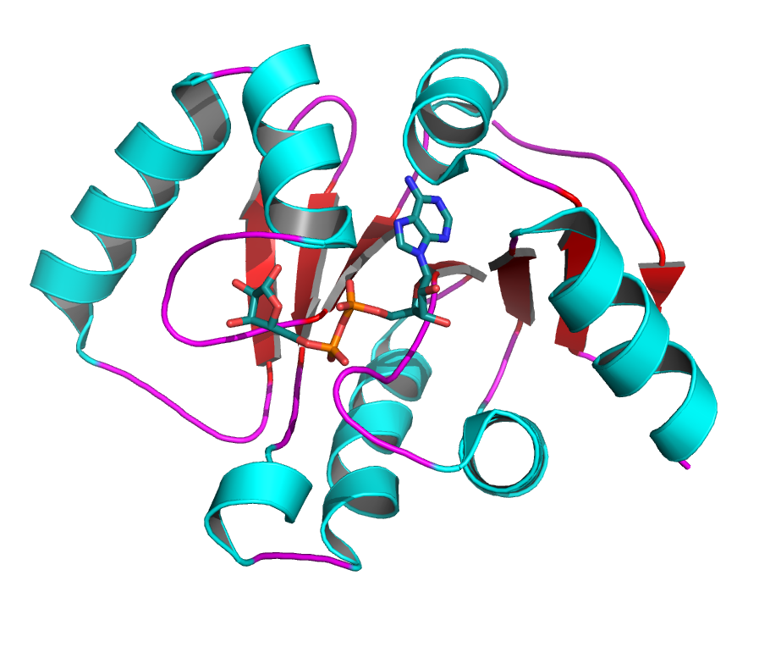
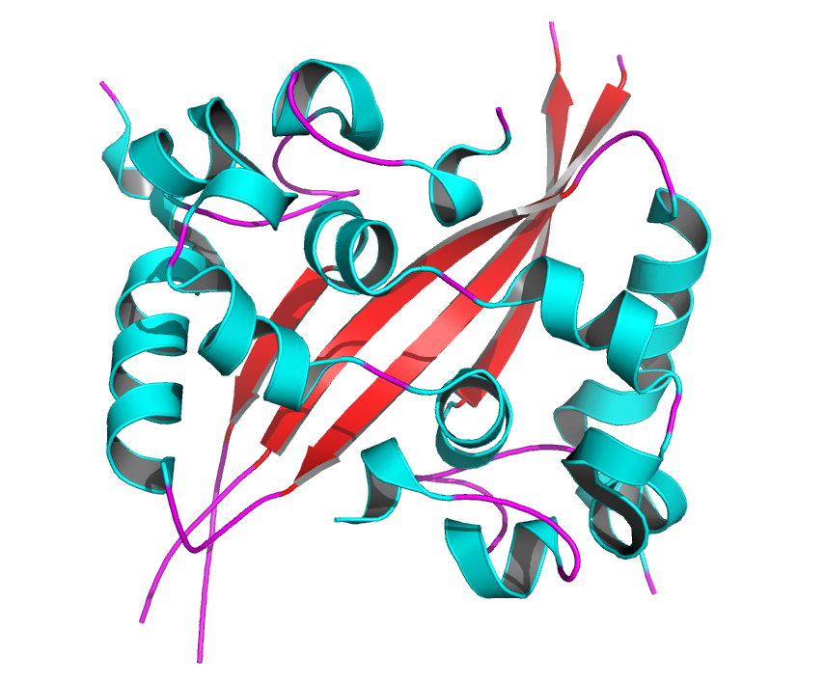
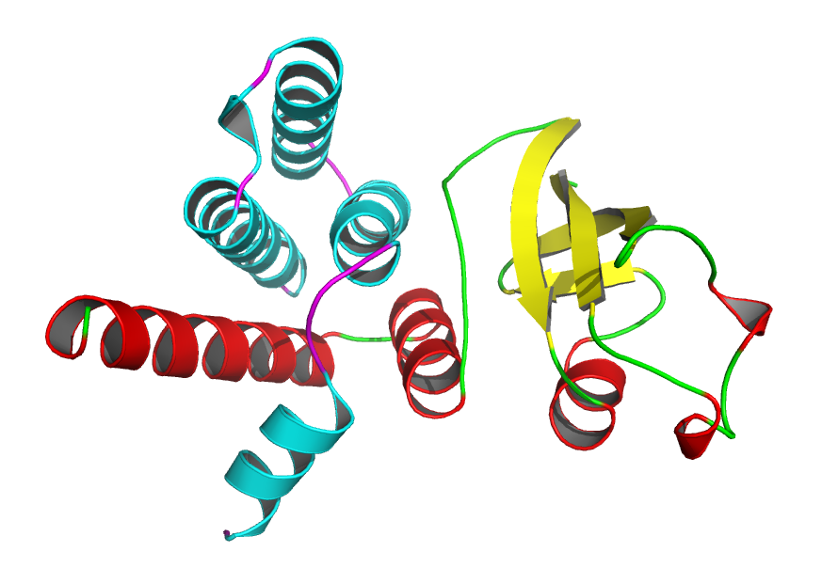
SARS-CoV-2 Genome and ANL/UC Structures
(+) RNA (29903)
Non-structural proteins
Structural & accessory proteins
Pp1ab (7096)
3a
7a
9b
Pp1a (4405)
AcPro
8
10
Nsp
1
2
3
4
5
6
7
8
9
10
12
13
14
15
16
Structures
Nsp10/16
3b
6
7b
9c
PLpro
ADRP
Mpro
Nsp7/8
Nsp9
Nsp15
S
E
M
N
Orf7a
N-RBD, N-Cter
6W37
6W9C, 6WRH, 6WZU
6W4B
6W63
6WPN
6WQF
6VXS, 6W02 6W6Y, 6WEN 6WCF
6W4H, 6W61
6W75, 6WKQ
6WJT, 6WVN
6WQ3
6WJI
PDB Deposits
6WIQ
6WQD6WTC
6VYO
6WKP
6W01, 6VWW
6WLC, 6WXC,
6X1B
Notes:
This slide contains images of viral proteins that have been solved at the APS and the list of PDB IDs for the related sets of proteins.
APS has solved more novel SARS-CoV-2 proteins than any other light source.

Slide 5
Receptor ID | Method | PDB Title
3CLPro_7BQY_A_1_F | X-Ray Diffraction | The crystal structure of covid-19 main protease in complex with an inhibitor n3 at 1.7 angstrom
ADRP_6W02_A_1_H | X-Ray Diffraction | Crystal Structure of ADP ribose phosphatase of NSP3 from SARS CoV-2 in the complex with ADP ribose
NPRBD_6VYO_A_1_F | X-Ray Diffraction | Crystal structure of RNA binding domain of nucleocapsid phosphoprotein from SARS coronavirus 2
NPRBD_6VYO_AB_1_F | X-Ray Diffraction | Crystal structure of RNA binding domain of nucleocapsid phosphoprotein from SARS coronavirus 2
NPRBD_6VYO_BC_1_F | X-Ray Diffraction | Crystal structure of RNA binding domain of nucleocapsid phosphoprotein from SARS coronavirus 2
NPRBD_6VYO_CD_1_F | X-Ray Diffraction | Crystal structure of RNA binding domain of nucleocapsid phosphoprotein from SARS coronavirus 2
NPRBD_6VYO_DA_1_F | X-Ray Diffraction | Crystal structure of RNA binding domain of nucleocapsid phosphoprotein from SARS coronavirus 2
NSP10-16_6W61_AB_1_F | X-Ray Diffraction | Crystal Structure of the methyltransferase-stimulatory factor complex of NSP16 and NSP10 from SARS CoV-2
NSP10-16_6W61_AB_2_F | X-Ray Diffraction | Crystal Structure of the methyltransferase-stimulatory factor complex of NSP16 and NSP10 from SARS CoV-2
NSP10_6W61_B_1_F | X-Ray Diffraction | Crystal Structure of the methyltransferase-stimulatory factor complex of NSP16 and NSP10 from SARS CoV-2
Nsp13.helicase_m1_pocket2 | Homology Model | Unpublished, helicase
Nsp13.helicase_m3_pocket2 | Homology Model | Unpublished, helicase
NSP15_6VWW_A_1_F | X-Ray Diffraction | Crystal Structure of NSP15 Endoribonuclease from SARS CoV-2
NSP15_6VWW_A_2_F | X-Ray Diffraction | Crystal Structure of NSP15 Endoribonuclease from SARS CoV-2
NSP15_6VWW_AB_1_F | X-Ray Diffraction | Crystal Structure of NSP15 Endoribonuclease from SARS CoV-2
NSP15_6W01_A_1_F | X-Ray Diffraction | The 1.9 A Crystal Structure of NSP15 Endoribonuclease from SARS CoV-2 in the Complex with a Citrate
NSP15_6W01_A_2_F | X-Ray Diffraction | The 1.9 A Crystal Structure of NSP15 Endoribonuclease from SARS CoV-2 in the Complex with a Citrate
NSP15_6W01_A_3_H | X-Ray Diffraction | The 1.9 A Crystal Structure of NSP15 Endoribonuclease from SARS CoV-2 in the Complex with a Citrate
NSP15_6W01_AB_1_F | X-Ray Diffraction | The 1.9 A Crystal Structure of NSP15 Endoribonuclease from SARS CoV-2 in the Complex with a Citrate
NSP16_6W61_A_1_H | X-Ray Diffraction | The 1.9 A Crystal Structure of NSP15 Endoribonuclease from SARS CoV-2 in the Complex with a Citrate
PLPro_6W9C_A_2_F | X-Ray Diffraction | The crystal structure of papain-like protease of SARS CoV-2
RDRP_6M71_A_2_F | Electron Microscopy | SARS-Cov-2 RNA-dependent RNA polymerase in complex with cofactors
RDRP_6M71_A_3_F | Electron Microscopy | SARS-Cov-2 RNA-dependent RNA polymerase in complex with cofactors
RDRP_6M71_A_4_F | Electron Microscopy | SARS-Cov-2 RNA-dependent RNA polymerase in complex with cofactors
RDRP_7BV1_A_1_F | Electron Microscopy | Cryo-EM structure of the apo nsp12-nsp7-nsp8 complex
RDRP_7BV1_A_2_F | Electron Microscopy | Cryo-EM structure of the apo nsp12-nsp7-nsp8 complex
RDRP_7BV1_A_3_F | Electron Microscopy | Cryo-EM structure of the apo nsp12-nsp7-nsp8 complex
RDRP_7BV1_A_4_F | Electron Microscopy | Cryo-EM structure of the apo nsp12-nsp7-nsp8 complex
RDRP_7BV2_A_1_F | Electron Microscopy | Cryo-EM structure of the apo nsp12-nsp7-nsp8 complex
RDRP_7BV2_A_2_F | Electron Microscopy | Cryo-EM structure of the apo nsp12-nsp7-nsp8 complex
RDRP_7BV2_A_3_F | Electron Microscopy | Cryo-EM structure of the apo nsp12-nsp7-nsp8 complex

Slide 6
Initial Data frame construction
orderable subset of the Zinc15 database (OZD)
orderable subset of the MCULE compound database (ORD)
compounds that are either in stock or available to ship in three weeks across a range of suppliers
Notes:
The first was the orderable subset of the Zinc15 database (OZD) and the second was the orderable subset of the MCULE compound database (ORD).
The generation of the orderable subsets was primarily a manual activity that involved finding all compounds that are either in stock or available to ship in three weeks across a range of suppliers.
We used OpenEye FRED for building those data frames;

Slide 7
100K-random
100K-flatten
1M-random
1M-flatten

Slide 8
Feature Impact
The 1613 2D MOrdred descriptors performed better than the 1826 2D + 3D features in most cases.

Slide 9
Training Set Size Impact
The 1M data frames performed better than the 100K data frames in most cases
The mean Pearson correlation coefficient of the 1M-flatten was higher than that of the 1M-random data frame

Slide 10
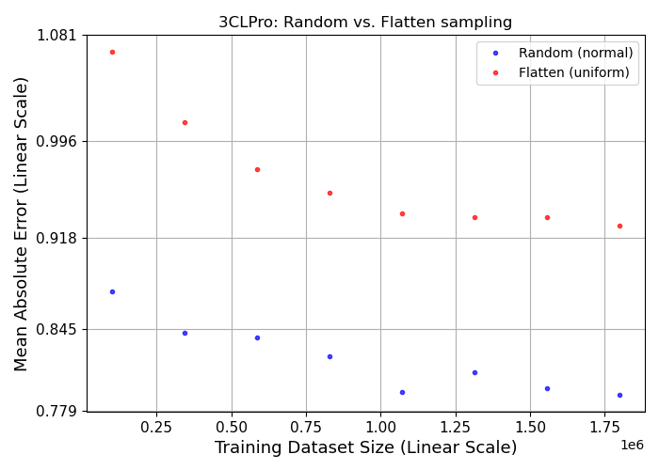
Learning curves
Partin et al. Learning curves for drug response prediction in cancer cell lines. BMC Bioinformatics. 2021 May 17;22(1):252.

Slide 11
Model training
The 1613 MOrdred descriptors performed better than the 1826 features in most cases.
The 1M data frames performed better than the 100K data frames in most cases.
The mean Pearson correlation coefficient of the 1M-flatten was higher than that of the 1M-random data frame.

Slide 12
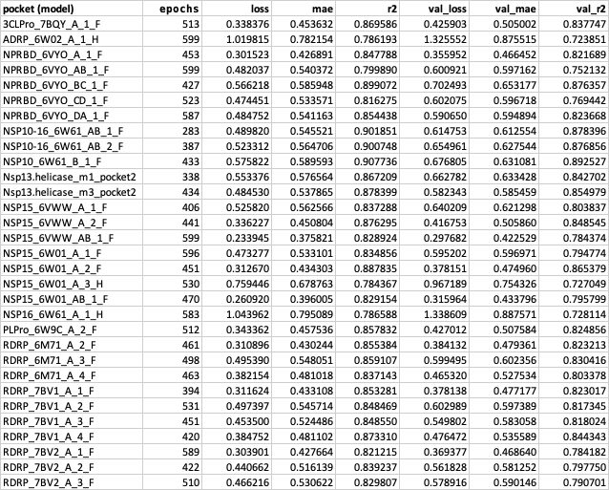

Slide 13
Hyperparameter Optimization
CANDLE Workflows
Notes:
Comparison of mlrMBO and GA optimized model with the default model

Slide 14
Inferencing
Searched over 3.8 Billion small molecules using 31 receptor binding pocket models
Featurized compounds available at:
https://2019-ncovgroup.github.io/data
Targeting SARS-CoV-2 with AI- and HPC-enabled Lead Generation: A First Data Release. Babuji et al. 2020 https://arxiv.org/abs/2006.02431

Slide 15
Inferencing
Targeting SARS-CoV-2 with AI- and HPC-enabled Lead Generation: A First Data Release. Babuji et al. 2020 https://arxiv.org/abs/2006.02431
3,800,000,000 compounds
50,000 predictions / second / GPU
76,000 seconds on one GPU
126 seconds on 100 nodes (summit)
Top 2000 scoring hits for each model selected for further analysis

Slide 16
Data and code availability
The trained models using the 1M-flatten data frame are currently at:
https://ftp.mcs.anl.gov/pub/candle/public/models/examples/adrp/
The neural network code is currently available at:
https://github.com/ECP-CANDLE/Benchmarks/tree/develop/examples/ADRP

Slide 18
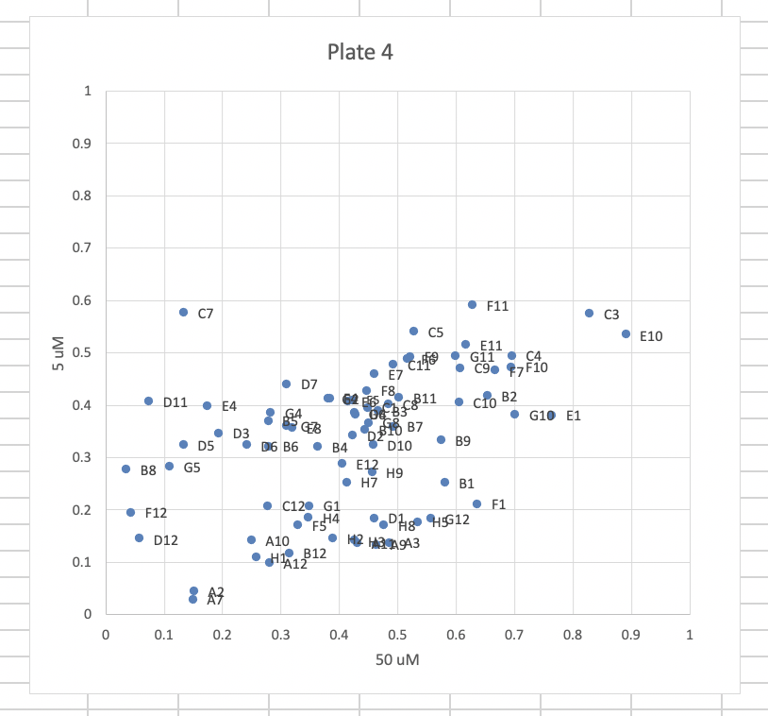
Early Screening Results from Whole Cell Assays

